Slide 1




Merck Animal Health Forecasting Project Week 17
Team: Abhishek Dixit, Benjamin Elbaz,
Anqi Huang, Shuang Wei
Advisor: Kris Iyer
Date: May 6, 2016

Slide 2
Agenda
1 – Sales Out Clustered Model – Nobivac
2 – Sales Out Unionized Model – Nobivac
3 – Sales In Clustered Model – Nobivac
4 – Sales In Unionized Model – Nobivac
5 – Sales Out Model – Activyl

Slide 3
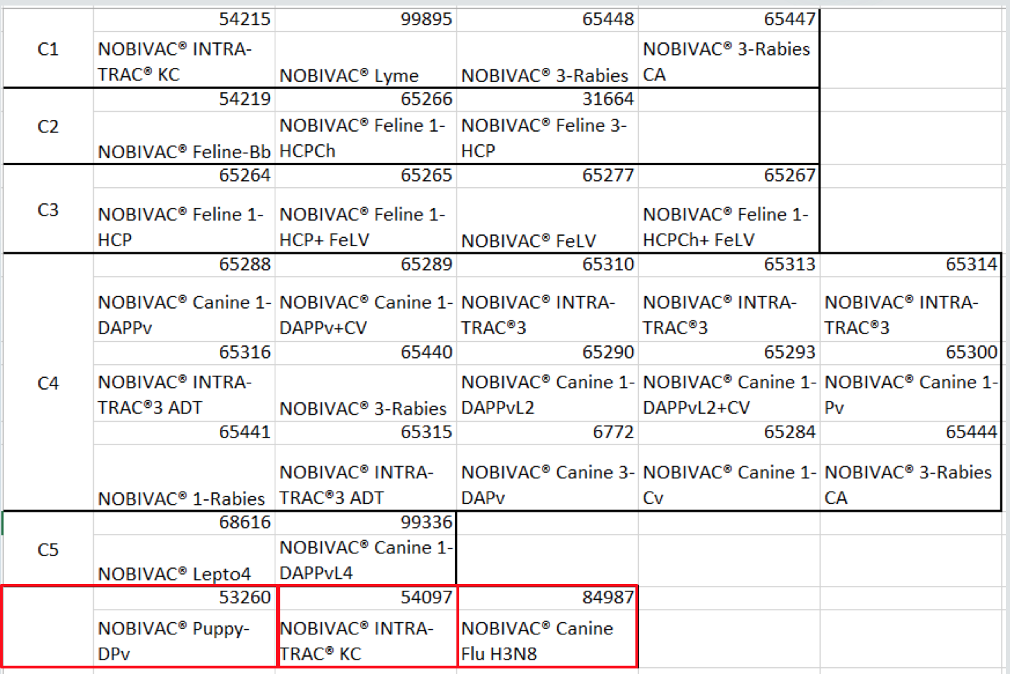
Nobivac Clusters
FELINE
FELINE
CANINE
No significant correlations with any other SKU =>Modeled these 3 individually

Slide 4
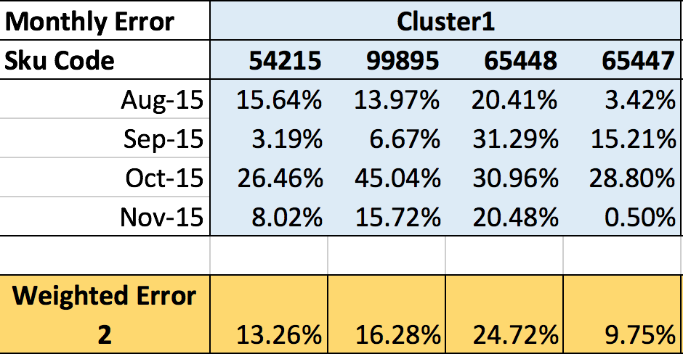
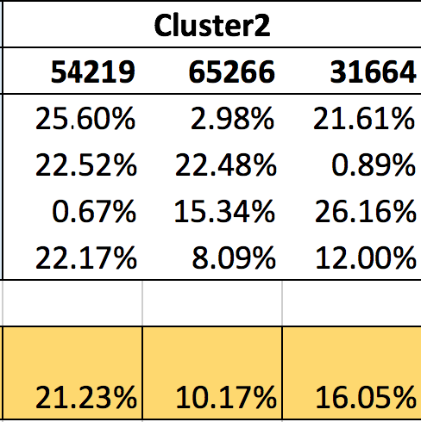
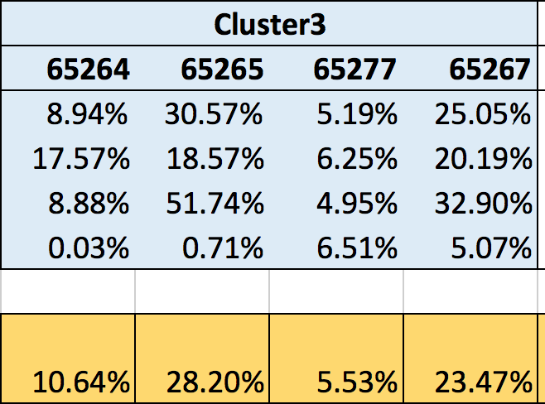
Sales Out Result by Clustered Model
- Applied each clustered Model to their respective SKUs:
Weighted Error 2 = [Error(1st Month) + Error(2nd Month)/2 + Error(3rd Month)/4 + Error(4th Month)/8]/1.875

Slide 5
Sales Out Result by Clustered Model

Slide 6
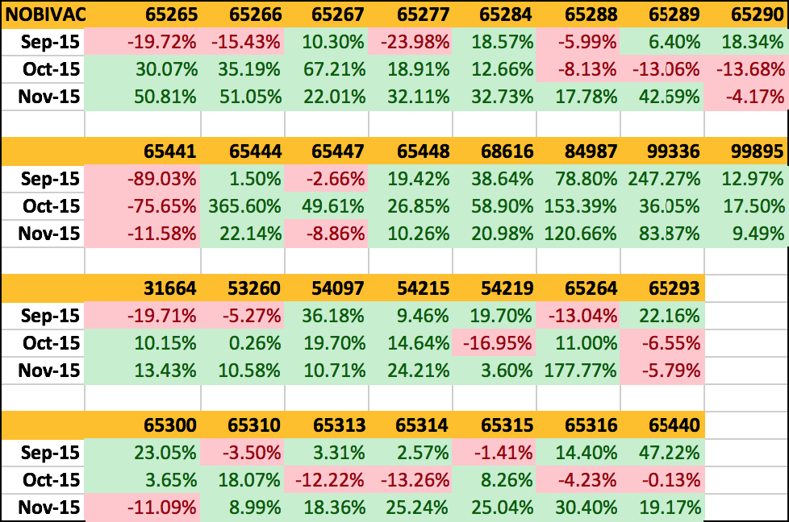

Sales Out Result by Unionized Model
- Applied the Unionized Model to each Sku:

Slide 7
Sales Out Result by Unionized Model

Slide 8
Sales In Result by Clustered Model
- Forecast 8-Month Sales In (2015.8 – 2016.3) using 7 Models on 5 Clusters:
 | Model 1 | Model 2 | Model 3 | Model 4 | Model 5 | Model 6 | Model 7
 | (SI only) | (SI, SO, Inv) | (SI, SO) | (SI, Inv) | (SI, Ext, Inv) | (SI, Ext) | (SI, Ext, SO) |  | Optimal Model | Lag of SO | Lag of Inv | Lag of Ext
8-Month Weighted Error for Cluster 1 | 43.21% | 17.89% | 20.64% | 41.24% | 20.89% | 21.29% | 17.38% | 5.14% | Model 7 (SI, Ext, SO) | 1 | 2 | 0
8-Month Weighted Error for Cluster 2 | 26.54% | 24.89% | 24.71% | 27.82% | 20.17% | 31.23% | 31.93% | 14.22% | Model 5 (SI, Ext, Inv) | 0 | 1 | 3
8-Month Weighted Error for Cluster 3 | 29.62% | 20.05% | 20.52% | 21.55% | 21.30% | 20.12% | 18.35% | 19.64% | Model 7 (SI, Ext, SO) | 1 | 5 | 3
8-Month Weighted Error for Cluster 4 | 36.47% | 29.66% | 29.90% | 34.71% | 29.42% | 33.06% | 30.40% | 22.81% | Model 5 (SI, Ext, Inv) | 0 | 0 | 1
8-Month Weighted Error for Cluster 5 | 57.84% | 53.88% | 53.42% | 57.75% | 60.00% | 58.81% | 54.05% | 49.89% | Model 3 (SI, SO) | 0 | 2 | 4

Slide 9
Sales In Result by Unionized Model
- Forecast 8-Month Sales In (2015.8 – 2016.3) using 7 Models on the Aggregate level:
 | Model 1 | Model 2 | Model 3 | Model 4 | Model 5 | Model 6 | Model 7
 | (SI only) | (SI, SO, Inv) | (SI, SO) | (SI, Inv) | (SI, Ext, Inv) | (SI, Ext) | (SI, Ext, SO) |  | Optimal Model | Lag of SO | Lag of Inv | Lag of Ext
8-Month Weighted Error on the Aggregate Level | 31.16% | 27.86% | 28.36% | 29.62% | 28.14% | 27.37% | 28.76% |  | Model 6 (SI, Ext) | 0 | 0 | 1

Slide 10
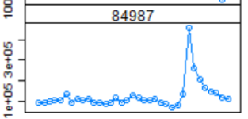
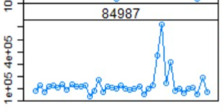
Business Insights
We recommend applying Clustered Model for Sales In forecasts.
(<20% error rate compared with Unionized Model’s 30%)
Clustering:
Clustering based on vaccine type makes sense (e.g. Feline, Canine, Rabies, etc.)
To achieve better result, cluster based on correlations of Sales In quantity
We recommend modeling 3 Skus individually given their current status:
Sku 53260 - NOBIVAC® Puppy-DPv; Sku 54097 - NOBIVAC® INTRA-TRAC® KC (1 x 10 dose);
Sku 84987 - NOBIVAC® Canine Flu H3N8
Modeling:
External Market Data is a significant factor in forecasting both Sales out and Sales In.
For Sales In Forecast, we recommend either using Model 5 (SI, Ext, SO) or Model 7 (SI, Ext, Inv).
Sale In Forecast:
Large errors exist for Cluster 5’s Sales In forecasts.

Slide 11
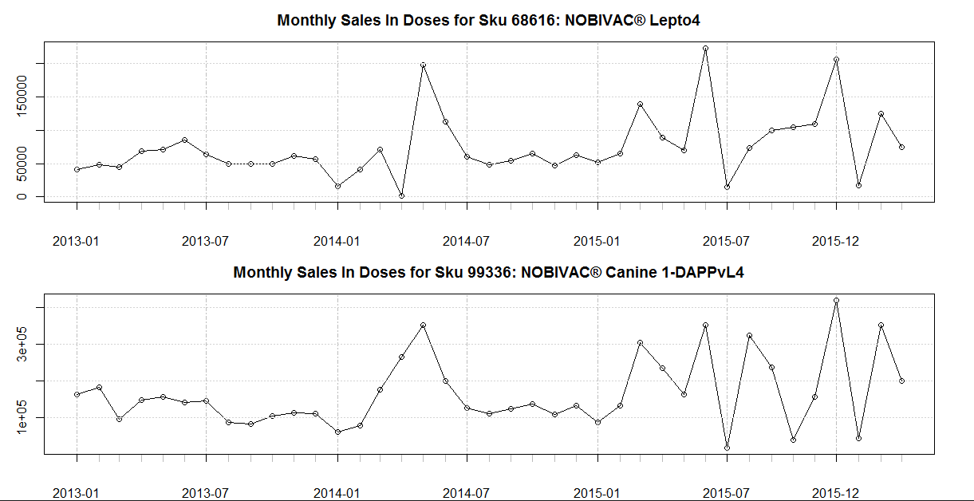
Monthly Sales In Plot for Cluster 5

Slide 12
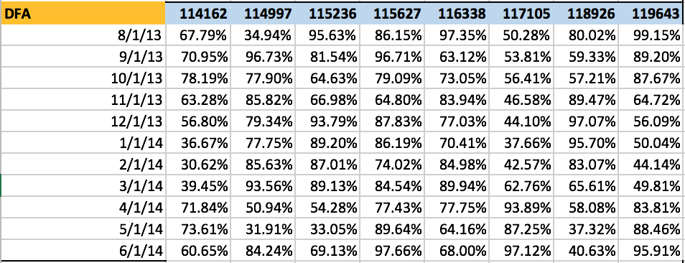
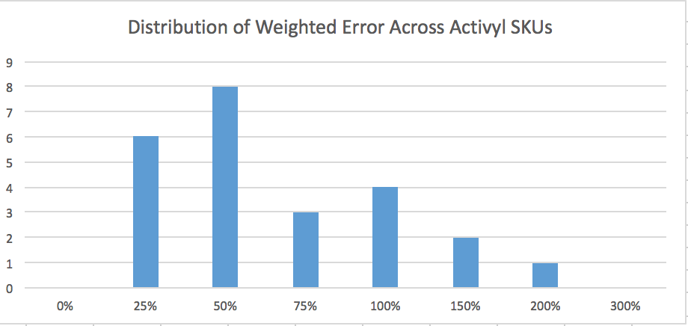
Sales Out Results - Activyl

